Slide 1
Personal Medical Assistant
Sujit Maiti
Rahul Das
Jason D’Souza
Sanish Aukhale

Slide 2
Introduction
The modern visionary of healthcare industry is to provide better healthcare to people in a more economic and patient friendly manner.
Therefore, for increasing the patient care efficiency, there arises a need to improve the system in place. It is important to give some kind of remote medical assistance whenever possible.
Automated medical assistance is the key. It is highly scalable, as many users can use it at a time and receive basic health assistance in a very convenient and easy way.

Slide 3
Features
Reminders
Sending timely alerts to the user to remind him/her to take medicines at the right time, if any, etc.
Health Monitoring
Provides necessary steps to be taken if user is having, any abnormal behaviour/symptoms shown by the body (high body temperature, difficulty in breathing, headaches etc.
In case of extreme symptoms, user is provided with further medical assistance.
Medical Emergency Phonebook
Provides contact details of nearest hospitals or health center.

Slide 4
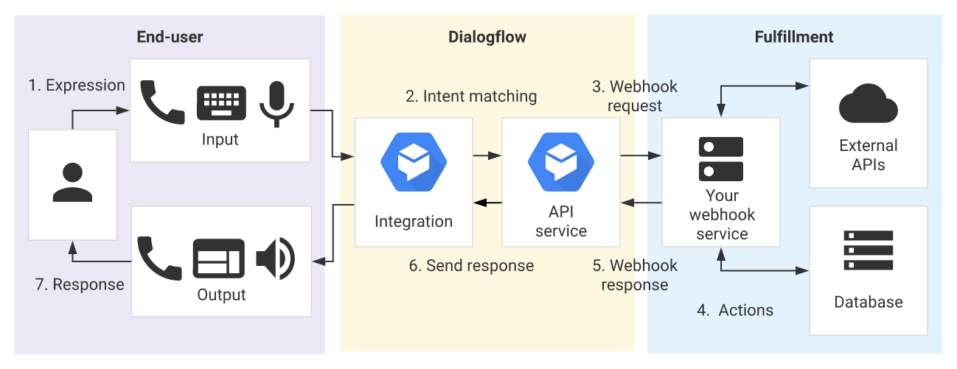
Our Approach
Use Google APIs like Actions, Dialogflow to create the main conversational chat model in order to get appropriate solutions.
With the help of Flask, backend will be handled via a webhook.
In order to get quick replies, it will be kept minimalistic.
Integration with assistant will allow to use it on any device with ease.

Slide 5
Thank You

